Slide 1

LFZDC Enterprise Digitization Platform
Integrated ERP, Smart Operations & Enterprise Services Solution
Prepared for:
Lekki Free Zone Development Company (LFZDC)

Slide 2
Table of Contents
Slide 3
Slide 4
Slide 5
Executive Summary
Our Understanding of the Problem
Our Proposed Solution
Slide 35
Slide 36
Slide 45
Proposed Implementation Plan
Solution Architecture
Benefit to LFTZC
07
08
09
Slide 46
Slide 48
Slide 50
Our Support Centre Overview
Next Steps
Corporate Profile

Slide 3

Executive Summary
LFZDC requires an integrated, scalable, and secure digital backbone to unify enterprise operations, automate workflows, improve regulatory compliance, and enhance investor experience.
We propose a modular, cloud-first enterprise platform anchored on:
A Tier‑1 ERP
Specialized Smart Zone & Security Systems
Enterprise & Investor Self‑Service Portals
Centralized Document, Records, Analytics, and Integration Layer

Slide 4
Our Understanding of the Problem
Heavy reliance on manual processes and spreadsheets
Fragmented departmental systems and data silos
Limited real-time visibility for management
Weak inter-departmental workflow coordination
Manual billing, compliance, and reporting processes
Disconnected security, utilities, and enterprise data

Slide 5

Our Proposed Solutions
A Unified Digital Platform comprising:
Enterprise Resource Planning (ERP)
Enterprise & Investor Portal
Document & Records Management
Reporting & Analytics Platform
Smart Security & Visitor Management
Utility & Metering Management
Integration & API Layer

Slide 6
Enterprise Resource Planning System

Slide 7
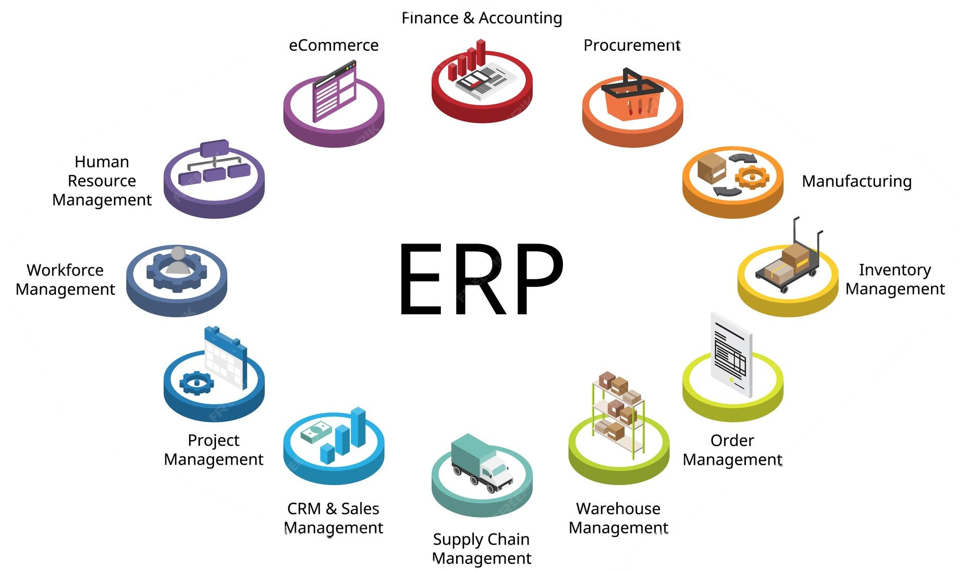
Enterprise Resource Planning System
Recommended ERP Options (Tier‑1 / Public Sector Proven):
Oracle Fusion Cloud ERP
Microsoft Dynamics 365 Business Central / Finance
Odoo Enterprise (Cost‑optimized alt)

Slide 8
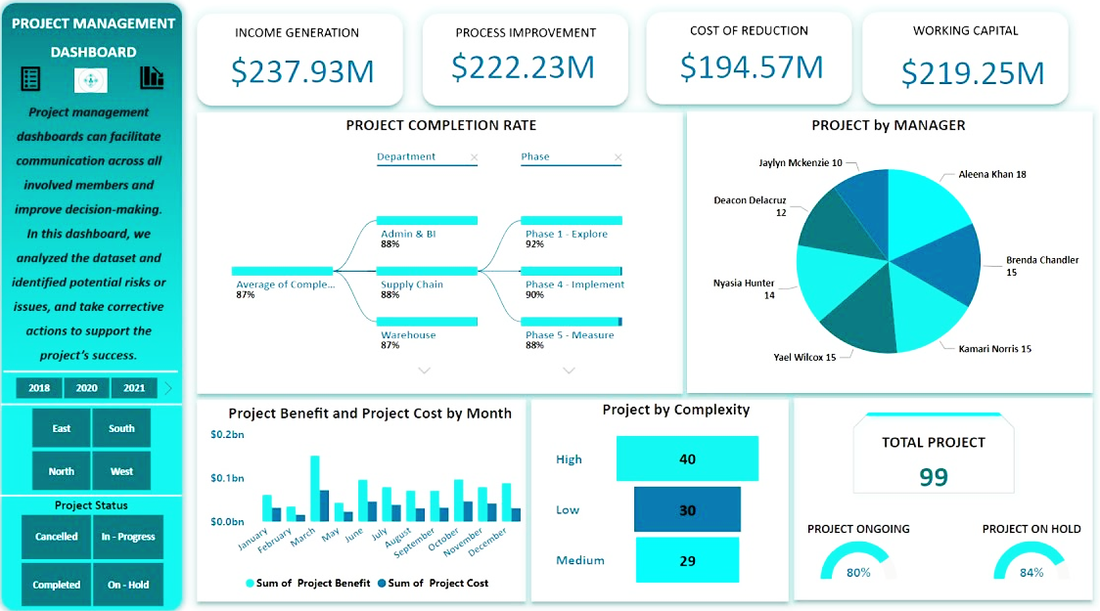
Sample Project Management Dashboard
Highly Customizable
RBAC enabled
Track
Infrastructure Development
Road Construction
Operations
Project status
Enterprise & Investor Portal
Document & Records Management
Reporting & Analytics Platform
Smart Security & Visitor Management
Utility & Metering Management
Integration & API Layer

Slide 9
ERP – Departmental Coverage
Finance: Receivables, billing, revenue recognition, budgets, SAP B1 replacement or coexistence
HR: Core HR, payroll, leave, performance, ESS
Admin: Procurement, vehicles, inventory, guest facilities
Construction: Project costing, milestones, contractor payments
Legal: Contract lifecycle, obligations, renewals

Slide 10
Smart Security & Visitor Management

Slide 11

Visitor Management System
World class expertise, local accessibility…

Slide 12
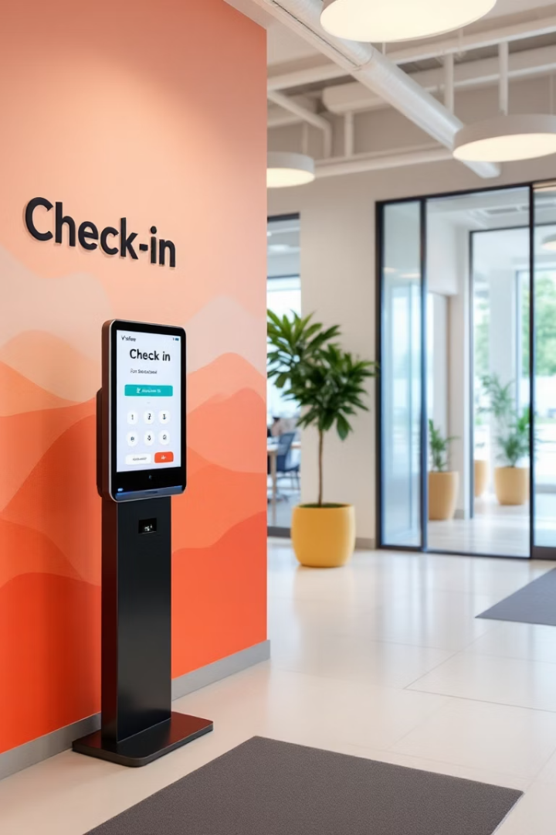

Core Capabilities
Gatepass booking (pre‑approved & walk‑in)
Instance deployed across enterprises with the Free Zone.
ANPR‑based vehicle recognition
Biometric-enabled passes for staff
Time-limited, Access Controlled for vendors and contractors
Multiple authentication points to prevent queue/stampede
Vehicle dwell‑time & traffic analytics
Integration with access barriers & CCTV
Alternative Platforms:
Genetec Security Center
HikCentral Professional
Milestone XProtect + Custom VMS
World class expertise, local accessibility…

Slide 13
Transforming Visitor Experiences with VisitUs
Heirs Technologies introduces VisitUs, a modern visitor management system.
Digitizes guest registration, check-in, communication, and tracking.
Trusted by organizations for improved efficiency and security.
World class expertise, local accessibility…

Slide 14

Challenges with Manual Visitor Management
Manual Logs
Unstructured and paper-based visitor records
Delays
Slow host notifications and check-ins
Limited Visibility
Reception staff lacks real-time data
Security Risks
Poor audit capabilities, poor visitor control
World class expertise, local accessibility…

Slide 15
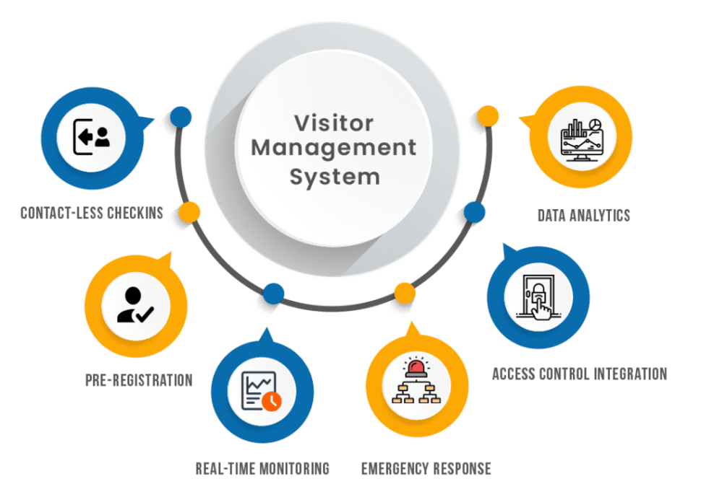
VisitUs’ Features
Pre-Booking
Seamless Check-In
Staff/Enterprises schedule visits conveniently ahead
Support for walk-ins and appointments
Real-time Tracking
Instant Communication
Visibility via visitor dashboards
Effortless visitor-host messaging
World class expertise, local accessibility…

Slide 16

VisitUs in Action
Visitor Directory
Staff Booking Module
Real-time dashboard overview
Visitor Entry Module
Advance scheduling form
Check-in/out tracking
Walk-in form with photo capture
Email alerts to visitor & receptionist
Filter by name, time, status
Automatic host email notification
Quick arrival check-in
Digital visitor record created
World class expertise, local accessibility…

Slide 17
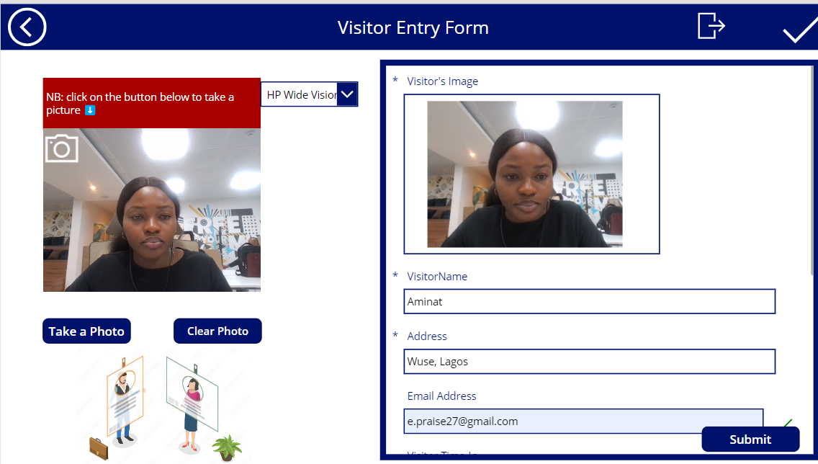
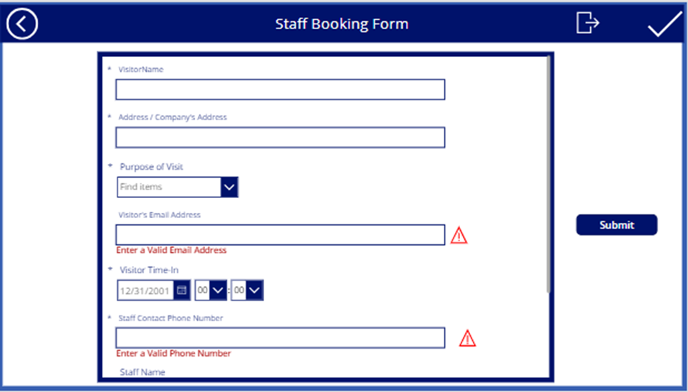
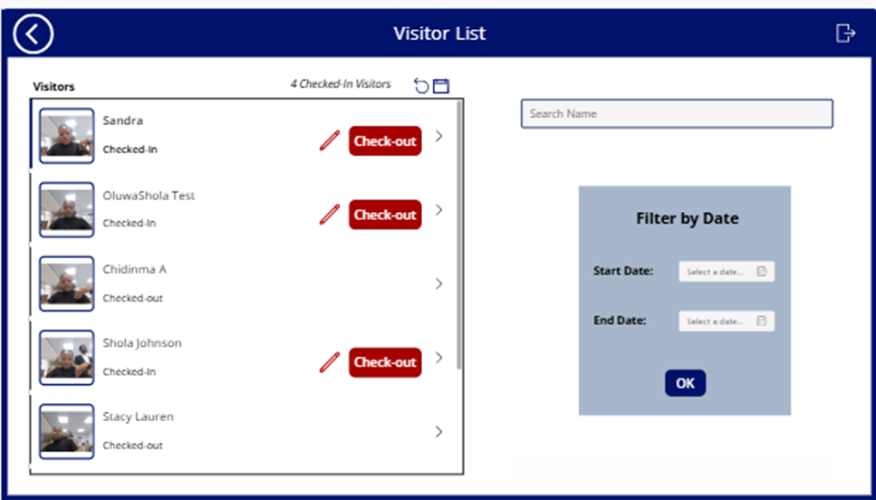
How it Works
1
2
3
Visitor Entry Module
Staff Booking Module
Visitor Directory
World class expertise, local accessibility…

Slide 18

What VisitUs Offers
Workload Reduction
Less manual data entry at reception
Enhanced Experience
Professional and streamlined visitor process
Improved Security
Real-time monitoring and alerts
Audit Ready
Reliable digital logs for compliance
World class expertise, local accessibility…

Slide 19
What You Get
Visitor Portal
Staff Booking
Reception Dashboard
Email Notifications
Web-based check-in system
Easy scheduling interface
Integrated communication setup
Access visitor history and status
Custom branding and optional email API included.
World class expertise, local accessibility…

Slide 20




Let’s Simplify Your Front Desk
Speed
Faster visitor processing
Security
Improved access control
Clarity
Clear visitor records and communication
Ready to deploy, integrate, and customize for your needs.
World class expertise, local accessibility…

Slide 21
Implementation Plan
Phase | Duration | Objectives | Key Activities | Deliverables
1. Kickoff & Requirements | Week 1 | Define scope, gather requirements, align on expectations | Kickoff meeting Collect branding assets Define workflows and visitor types Identify email/SaaS integration needs | Requirements doc Implementation timeline Access setup
2. Configuration & Setup | Week 2 | Customize system and apply branding | Set up VisitUs instance Customize forms and dashboards’ Configure email notifications Create user/admin roles | Configured system Branding applied Email integration
3. UAT (Testing) | Week 3 | Validate functionality and collect feedback | Simulate check-ins/bookings Test dashboards and alerts Capture feedback Apply necessary adjustments | UAT test report Feedback log- Final config (if any)
4. Training & Preparation | Week 4 | Train staff and finalize go-live readiness | Train reception/admin/host users Distribute user manuals Finalize visitor directory and SOPs | Staff trained SOPs ready Go-live checklist
5. Go-Live & Support | Week 5 | Launch the system and support adoption | Launch VisitUs in production Monitor usage and resolve issues | System live First-week usage report Issue log
6. Post-Implementation Review | Week 6 | Review performance and transition to support | Review KPIs Conduct debrief and satisfaction survey Transition to support or SLA agreement | Closure report Support handover Optional rollout roadmap
World class expertise, local accessibility…

Slide 22
Smart Security & Incident Management
Integrated systems for:
Access control (biometric, RFID)
CCTV & smart video analytics
Incident reporting & escalation
Central Command & Control Dashboard
All security data synchronized with enterprise and visitor records.

Slide 23
Document & Records Management

Slide 24
Document Tracking and Control System
Centralized, secure, searchable document repository.
External enterprise document access
Version control & audit trails
Role‑based access
OCR, Metadata indexing, IDP
Workflow-linked documents
01
02
03
04
05
Technology Options
Oracle WebCenter Content
Microsoft SharePoint Online
Alfresco Enterprise

Slide 25
Utility & Metering Management

Slide 26
Utility & Metering Management Project & Utility Services Department (PUSD)
Smart electricity & water meters
Remote data capture & validation
Usage dashboards & anomaly detection
Automated billing handoff to Finance
Preventive maintenance alerts
Integrated directly with ERP Finance & Enterprise Portal.
FEATURES

Slide 27
Reporting & Analytics Platform

Slide 28
Reporting Dashboard
Enterprise BI Layer delivering:
+
Executive dashboards (Finance, Operations, Security)
Investor & land allocation analytics
Compliance & audit reports
Import/export & inventory insights
+
+
+
Technology Options
Oracle Analytics Cloud
Microsoft Power BI
Tableau

Slide 29
Enterprise & Investor Portal

Slide 30
Enterprise & Investor Portal
A secure, branded LFZDC Digital Portal for:
Investor onboarding & profile management
Permit & license applications
Invoice viewing & payment tracking
Document download (DLAs, permits, receipts)
Inspection & compliance status
Notifications & announcements

Slide 31
Integration & API Layer
Phased coexistence or migration
SAP B1
Doc & Records Mgt
1
4
ERP
Metering Systems
2
Technologies:
REST APIs
Middleware (Oracle Integration Cloud / Azure Logic Apps)
+ Reporting & Analytics Platform
Security Systems +
VMS
Enterprise & Investor Portal
3
5

Slide 32
Solution Coverage by Department & Phase
Department | Key Digital Needs | Proposed Solution(s) | Implementation Phase
Finance | Receivables, billing, budgeting, revenue recognition, utilities reconciliation | ERP (Finance), BI & Analytics, Integration Layer | Phase 1 (Core), Phase 2 (Extensions)
Human Resources | Core HR, payroll, leave, performance, ESS, digitization | ERP (HCM), DMS | Phase 1
Legal | Contract lifecycle, approvals, compliance, NEPZA tracking | ERP (Contracts), DMS, Workflow Engine | Phase 2
Marketing / Investor Relations | Investor CRM, land allocation, invoicing, progress tracking | Enterprise & Investor Portal, ERP (CRM), BI | Phase 2
Operations | Enterprise registry, permits, compliance, inventory, imports/exports | ERP (Operations), Portal, DMS, Analytics | Phase 2
Construction | Project monitoring, milestone validation, cost tracking | ERP (Projects), Construction Monitoring Tools, BI | Phase 1
PUSD (Utilities) | Metering, utility billing, workflows | Smart Metering System, ERP Integration, BI | Phase 2 (Pilot), Phase 3 (Scale)
Security | Visitor mgmt, ANPR, access control, CCTV, incidents | Visitor & Vehicle Mgmt, Access Control, CCTV, Incident Mgmt | Phase 3
Admin / General Services | Procurement, vehicles, inventory, guest rooms | ERP (Procurement & Assets), Adm | Phase 1 and 3

Slide 33
Solutions-to-Department Mapping
Current Area | Proposed Replacement
SAP B1 (Finance) | Oracle Fusion ERP / Dynamics 365
Spreadsheets | ERP + BI Dashboards
Manual Gate Logs | ANPR + VMS
Paper Records | DMS + ERP Records
Isolated CCTV | Unified Smart City Platform

Slide 34
Proposed Implementation Plan
04
03
02
01
Foundation & Core ERP
Enterprise Services & Portals
Smart Operations & Security
Optimization & Advanced Analytics
A low‑risk, phased rollout minimizing disruption

Slide 35
Proposed Implementation Plan – Phased Approach
Phase 1
Foundation (0–5 Months)
Software:
ERP Core (Finance, Procurement, HR)
DMS deployment
Identity & Access Management
Construction monitoring tools
Hardware / Infrastructure:
Cloud environment setup
Network & security baseline
Phase 2
Enterprise Operations (5–11 Months)
Software:
Investor & Enterprise Portal
Legal contract management
Permit & license workflows
Utility metering integration
Hardware:
Smart meters rollout (priority enterprises)
Phase 3
Smart Security & Field Operations (12–15 Months)
Software:
Visitor & Vehicle Management
Incident Management System
Hardware:
ANPR cameras
CCTV expansion
Biometric access devices
Phase 4
Optimization & Intelligence (16–18 Months)
Advanced analytics & AI insights
Performance optimization
Regulatory integrations
Continuous improvement & training

Slide 36
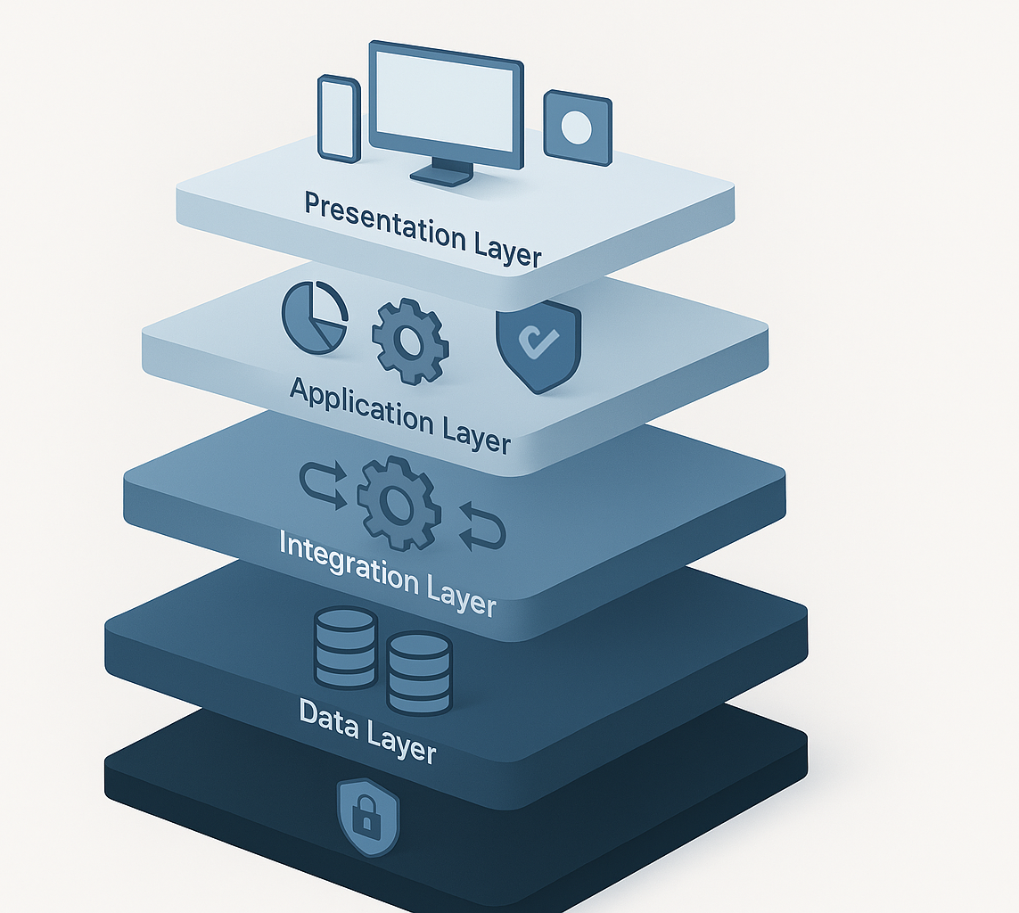
Solution Architecture

Slide 37
High-Level Solution Components
Presentation Layer: Web, Mobile, Portals
Application Layer: ERP, Security, Utilities, Workflows
Integration Layer: APIs & Middleware
Data Layer: Centralized Cloud Databases
Analytics Layer: BI & Reporting
Security Layer: IAM, MFA, Audit Logs
Cloud‑hosted, scalable, and secure.

Slide 38
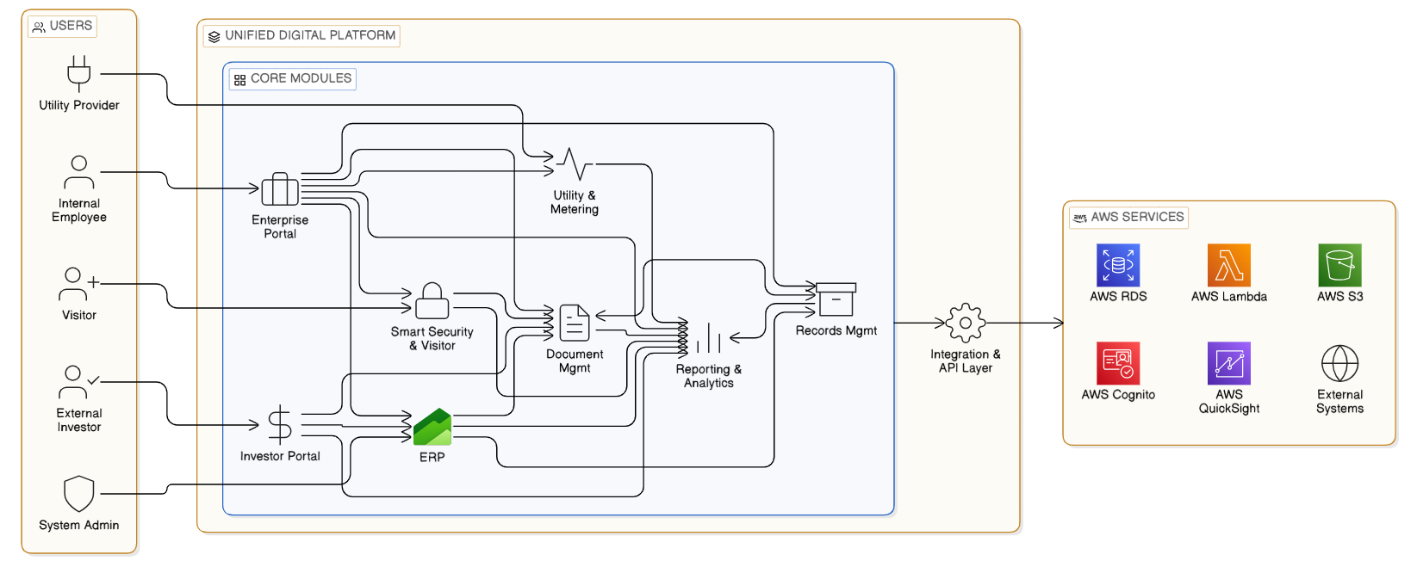
Solution Architecture (High Level)

Slide 39
Component Description (A)
External Systems
Utility & Metering
Third-party applications or legacy systems that integrate with the platform.
Monitors and manages utility consumption and billing.
Utility Provider
Records Mgmt:
External entity that supplies utilities, interacts with the platform for metering and billing.
Handles document storage, retention, and compliance.
AWS QuickSight
Integration & API Layer
Business intelligence tool for data visualization and reporting.
Enables seamless data exchange between modules and external systems via APIs.
AWS Cognito
AWS RDS
User authentication and authorization service.
Managed relational database service for storing application data
AWS S3
AWS Lambda
Scalable object storage for documents and backups.
Serverless compute for running code in response to events.

Slide 40
Component Description (B)
ERP
Internal Employee
Enterprise resource planning for finance, HR, and supply chain management.
Staff member who uses enterprise portal and ERP for daily operations.
Smart Security & Visitor
Visitor
Manages physical security, visitor check-in, and access control.
Guest who may use smart security for access and visitor management.
External Investor
Enterprise Portal
Stakeholder who accesses records and analytics for investment insights.
Provides a single point of access for employees and external users to company information and applications.
Unified Digital Platform
System Admin
Central hub that integrates all core modules and services.
Manages platform, user access, and system configuration.

Slide 41
Security| Technical Architecture
OAuth 2.0 client credentials flow
JWT token validation and management
API key authentication for system-to-system calls
Multi-factor authentication for administrative access
Authorization code flow with NRS MBS credentials
Certificate-based authentication where required
Single Sign-on
Data minimization principles
Purpose limitation for data collection
Consent management for optional data
Right to erasure compliance
Data anonymization for analytics
Secure data sharing protocols
Authentication
Privacy
Fine-grained RBAC for UI roles
Immutable audit log stream in NoSQL
Database with retention policy.
Complete transaction history tracking
User action logging with timestamps
Authorization
Policy checks centralized at gateway and enforced in services.
Programmatic access to ERP with defined scope
Auditing & System Integrity Controls
AES-256 encryption for database storage
Encrypted backups and archives
File-level encryption for sensitive documents
TLS 1.3 for all API communications
End-to-end encryption for invoice transmission.
NDPR‑aligned data protection
Encryption
World class expertise, local accessibility…

Slide 42

Data Migration Strategy

Slide 43
Two Strategic Migration Options
Option 1: Phased Coexistence with Selective Migration (Recommended)
Only current and operationally relevant data is migrated into the new ERP.
SAP Business One is retained in read-only mode for historical reference and audits.
New ERP becomes the system of record from go-live onward.
Delivers lower risk, faster deployment, and stronger audit defensibility.
This option aligns best with LFZDC’s phased digitization approach and public-sector governance requirements.
Option 2: Full Historical Migration
All historical financial data is fully transformed and migrated into the new ERP.
SAP Business One is fully decommissioned.
Provides a single system but introduces higher cost, longer timelines, and higher reconciliation risk.
This option is only advisable where SAP B1 data quality is exceptionally high and historical analytics is mission-critical.
Data Migration Strategy

Slide 44

















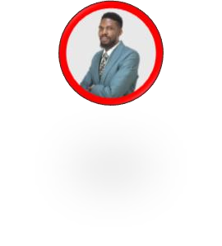




Team Composition
Our proposed Heirs Tech team of experts will ensure successful project delivery for LFTZDC
Ag CTO
Romanus Eke
Project SMEs
Engagement Leadership
VP, Ops & Delivery
Alozie Nzenwa
Our lead engagement manager will be Romanus Eke, supported by our experienced Technical Team. They are proven to be client-centric and professional client satisfaction and quality of delivery and support the leveraging of Heirs Technologies
Core Delivery Team
Solutions Architect
Oluwaseun Omotunde
Customer Success
Flora Ayaruja
System Integration
Osahon Elaiho
Cloud Engineer
Olugboyega Ojelabi
Software Developer Ezechukwu Emmanuel
Project Engineer
Victor Adeife
Network Engineer Darnell Shaka- Momodu
Software Engineer
Olalekan Durojaiye
Cloud Engineering
Marvelous Abolade
Support
Victor Ndulue
Full time dedicated resources are subject to availability. Support teams will be further allocated during the engagement kick-off.
World class expertise, local accessibility…

Slide 45
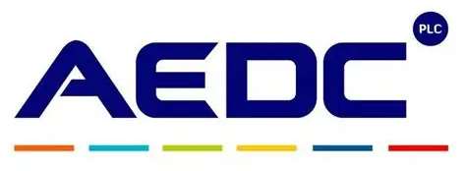














Local Expertise
Heirs Technologies has a reputation for helping organisations achieve full implementation of their digitall roadmap.
Process Automation and Digitisation
ERP Deployment
Security
Digitisation of Billing, Vending, Energy Management, Inventory, Unified Collections…
Checkpoint Cloudguard and Checkpoint Upgrade – Perimeter solution
Oracle Fusion
Process Automation
Visitor management
Payment processing platform
Security Escort request application
Vulnerability Assessment and Penetration Testing
Converge
Supervisory Control and Data Acquisition
Dynamics 365
IT Audit and Pen Test
World class expertise, local accessibility…

Slide 46
Benefits to LFTZ
End‑to‑end digitization
Faster service delivery to enterprises
Improved revenue assurance
Real‑time management visibility
Enhanced investor confidence
Scalable Smart Zone foundation

Slide 47


₀₈ Our Support Centre
Overview
44
World class expertise, local accessibility…

Slide 48











Our Customer Call & Support Centre Overview
Delivering 8x5 Global Support with Local Excellence
Support Service Features
People NRSt: Training, Culture & Retention Strategy
Support Model
8x5 support via multiple channels (Emails,
ITSM, VoIP)
with SLA-driven workflows, knowledge base management.
Cultural Immersions
Long-Term Growth
Agents trained on regional etiquette, empathy., environment appreciation.
Retention Model
Internal career progression paths, Quarterly recognition programs, wellness support, check-ins
Ongoing Training
Knowledge Transfers, Product updates, cross- skills programs, mentoring
/ modelling
Tier 1
Tier 2 Tier 3
Security & Compliance
IT Service Management (ISO/IEC 20000-1:2018)
Quality (ISO 9001:2015
Information Security (ISO/IEC 27001:2022)
Business Continuity (ISO 22301:2019)
GDPR Compliant
Performance Management
SLA compliance rate
NRSt Contact Resolution %
Average Handling Time
Escalation rate
Scalability & Customization
Team scalability
Multilingual teams
Tools
ITSM
Feedback Mechanisms
Post-interaction surveys (Email/ and other channels)
Sentiment analysis
Onboarding Curriculum
Product/tool training (ITSM, Ticketing, soft skill training, culture immersion – US/UK norms, workplace behavior
Quality Assurance
Rotational Shift
Structure
8-hour shift
Daily scorecards, call audits, and
resolution effectiveness.
Day time coverage
Afternoon/Evening Coverage
Nighttime Coverage
Initial Integration
CSAT
NPS
CES SENTIMENTS
World class expertise, local accessibility…

Slide 49
Next Steps
Alignment & Scope Confirmation
Detailed Requirements Validation & Process Mapping
Solution Architecture Review
Commercial Proposal Development
Contracting
Phase 1 Implementation

Slide 50

Conclusion
This phased, hybrid financial model minimizes upfront risk while enabling LFZDC to scale into a full Smart Zone ecosystem with predictable long-term costs.

Slide 51
09 Corporate Profile

Slide 52

About Us
Introduction
Heirs Technologies
Is more than a technology provider – we are architects of Africa’s digital future. With a deep understanding of the continent’s unique business landscape, we deliver innovative, tailored solutions that empower organisations to thrive in an ever- evolving digital economy.
Our expertise spans Managed Services (IT, Cloud, Cyber, Networks), Data & AI Business Transformation and Consulting, Product Innovation, Talent Management Outsourcing and OEM Licensing and Renewals, establishing us as a trusted partner for businesses seeking efficiency, growth, and resilience.
With a strong pipeline of skilled technical engineers, we are transforming Africa’s technology ecosystem and shaping a future where African businesses set the global benchmark for digital excellence.
World class expertise, local accessibility…

Slide 53

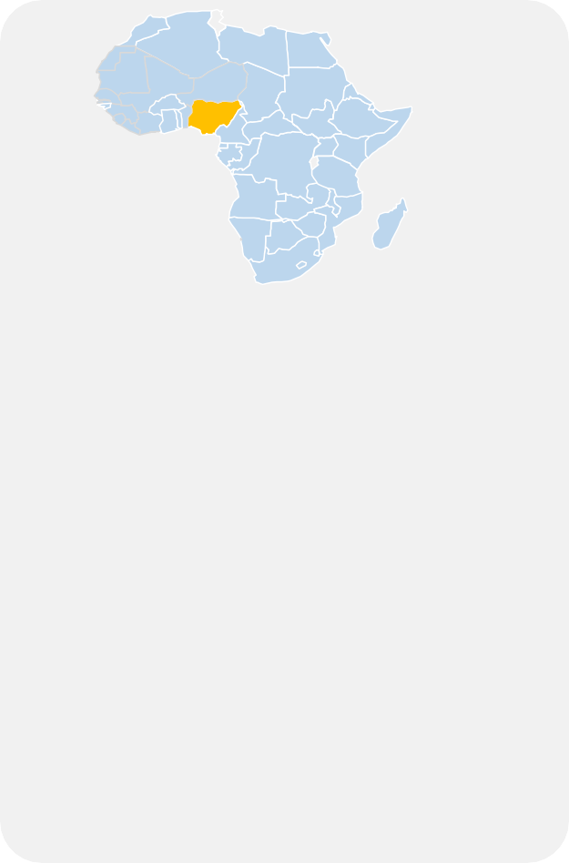

Heirs Technologies at a glance
Heirs Tech has a full spectrum of world-class talent and a comprehensive suite of capabilities that help clients perform better.
Total headcount
> 100
Language
English
Revenue in US$
$41.2Mn
No of countries
> 18
WORLD-CLASS CAPABILITY AND TALENT
Managed Services (IT & Apps)
Cloud AWS, Azure,
GCP
Business
Process & IT Consulting
Heirs Technologies
Physical presence in Lagos & Abuja and we provide technology support services to 19 countries where United Bank for Africa (clients) operates
Over 100 professionals and 55
partners in Africa
Heirs Tech provides services to over 30+ clients – FSI, Oil & Gas, Government, Energy & Utilities, and SMBs
Software Development
Data & AI
Product Innovation
Cybersecurity
HOW WE COLLABORATE
HOW WE DEVELOP DEEP CAPABILITY AND TALENT
Financial Status
International Certifications
Heirs
Technologies
FY24 Revenue
(Deal Size)
$41.2Mn
Information Security Management System Standard ISO/IEC 27001:2022,
BCM (ISO 22301:2019), Quality (ISO 90001:2015) & ITSM (ISO/IEC: 20000-1:2018)
World class expertise, local accessibility…

Slide 54

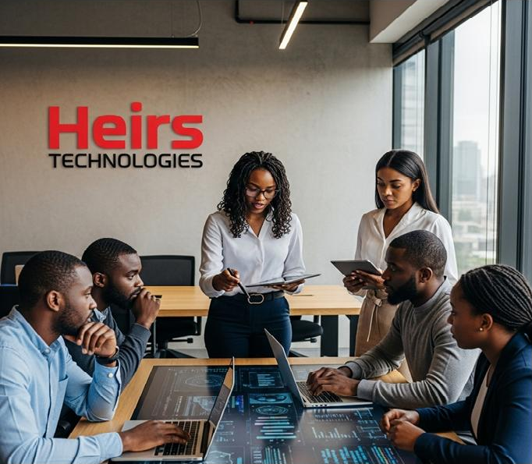

Who We Are
Heirs Technologies is a proudly African technology services and innovation company - a subsidiary of Heirs Holdings, established to drive digital transformation globally. We bridge local realities with global standards to deliver intelligent, scalable, and secure digital solutions tailored specifically to the African context.
Pan-African Presence
Established operation's strategic locations across Africa giving us deep insight into regional market dynamics while maintaining global delivery standards.
Expert Team
Skilled technology professionals with specialized expertise across multiple domains, from cloud architecture to AI implementation, managed services and cybersecurity.
Strategic Partnerships
Strong alliances with global technology leaders including Microsoft, Oracle, AWS, GCP, Salesforce, ServiceNow and Fortinet, enabling us to deliver best-in-class solutions with local support.
Our approach combines deep African market knowledge with global technology standards, allowing us to create solutions that address the unique challenges and opportunities of African enterprises.
World class expertise, local accessibility…

Slide 55



Available Technical Skills in Heirs Technologies

Slide 56
Technical Skills: Heirs Technologies, Nigeria [1/3]
Technology | Platform | Skillsets | Certifications
Cloud Infrastructure | Azure, AWS, & GCP | Server, VM, Database Configuration & Migration Services, VMware Migration Services, Advanced Networking, Storage & File Systems, BCP & DR, DevOps, App Migration & Modernization, Cloud Security, Landing zone deployment and customization, Cloud FinOps, Cloud Managed Services | Level 1 to Level 3 Technology Certifications
Modern workplace (Productivity & Collaboration) | M365 | Modern Workplace solutions for Government, Enterprise, Corporate & Consumer environments; Modernized Communication Solutions (MS Teams), Modernized Endpoints | Level 1 to Level 3 Technology Certifications
Business Applications | SW Dev., D365, Power Automate, Power BI/Apps | Microsoft AD, Finance & Operations, Business Central, Power Apps, Power Automate, Power BI, Field Service, Projects, Software development | Level 1 to Level 3 Technology Certifications
Security & Compliance | Azure, AWS, GCP | Threat Protection & Modern SOC, Azure Hybrid & Cloud Security, Information Protection & Governance, Identity & Access Management. AWS Control Tower, AWS Security Hub | Level 1 to Level 3 Technology Certifications
World class expertise, local accessibility…

Slide 57
Technical Skills: Heirs Technologies, Nigeria [2/3]
Technology | Platform | Skillsets | Certifications
Databases/ERP/ Systems Integration | Oracle databases, Oracle Fusion Cloud | Database administration, configuration management, monitoring, break & fix support, Oracle Fusion support across all modules and customization. Others include Microsoft SQL, MySQL, MongoDB, etc. | Level 1 to Level 3 Technology Certifications
Converge ERP | ERP Sales Cloud, Service Cloud, Energy & Utilities Cloud, Agentforce, and Marketing Cloud | Converge administration, development, implementation and. Integrations services to various accounting systems, cloud-native and legacy systems. Break and fix support as well as custom development | Deep domain expertise in object-oriented design, design patterns and their application, databases design, modelling and enterprise architectures.
Service Management (ITSM) | ServiceNow | IT Service Management (Service Desk), IT Compliance, incident, problem, & change management, systems integrations & process automation | Level 1 to Level 2 Technology Certifications
Cybersecurity | Cloud or On- premises | Security Operations Centre (SOC) services and Intelligence, Managed Security Services, Penetration Testing, Digital Forensics and Incident Response. Virtual CISO Services | Level 1 to Level 3 Technology Certifications
World class expertise, local accessibility…

Slide 58
Technical Skills: Heirs Technologies, Nigeria [3/3]
Roles | Tech Stack | Expertise
Application Developers | C#, Java, Spring MVC, ASP .NET MVC, .NET Core, SQL Server, SOA development, XML, Angular, HTML & CSS, Web Services, Service & Enterprise Oriented Architecture / REST, API, PLSQL, BI, NewGen | Deep domain expertise in object-oriented design, design patterns and their application, databases design, modelling and enterprise architectures. Expertise including designing & implementing large scale distributed systems
Frontend Engineers | Web Technologies like HTML, CSS, Angular, Vue, React.JS, React native, JavaScript and jQuery, Bootstrap, Markup Languages like XML and JSON., Unix Scripting | Strong knowledge of web development frameworks and 12-Factor App methodology
World class expertise, local accessibility…

Slide 59

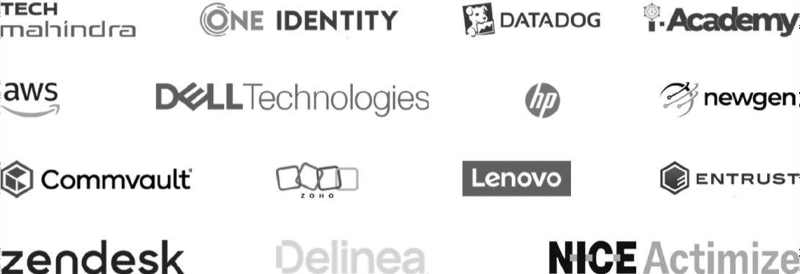



















Our Partners
Our Clientele
Our Products
World class expertise, local accessibility…

Slide 60


